Slide 1
MATLAB Programming
Coding Meetup 22/02/2018

Slide 2
Pros / Cons
Very convenient for data analysis, exploration
Huge library of built-in functions
Easy to prototype solutions
Especially useful for matrix/vector manipulations
Quick-to-make figures (built-in)
Quick-to-make GUIs (built-in)
Fully featured enough to be able to implement most design patterns
Large online community (e.g. StackOverflow) + extensive documentation
Easy to debug
Dynamic typing
Graphics options can be limited, doesn’t play well with external libraries
Interpreted language, never going to be the fastest solution (though see .mex)
Can become clunky and difficult to manage for large projects
Built-in aspect is sometimes a ‘con’, tailored approach can sometimes be tricky
Dynamic typing

Slide 3
Contents
Variables
  Variable behaviour
  Basic data structures
  Indexing approaches
Functions
Control flow
Function handles
Anonymous functions
Recursion
OOP in MATLAB
MATLAB Challenge

Slide 4
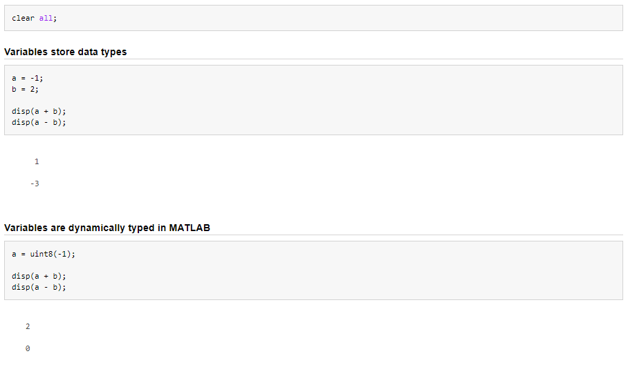
Variables
Variables are containers for a data type, so that they can be referenced throughout a program

Slide 5
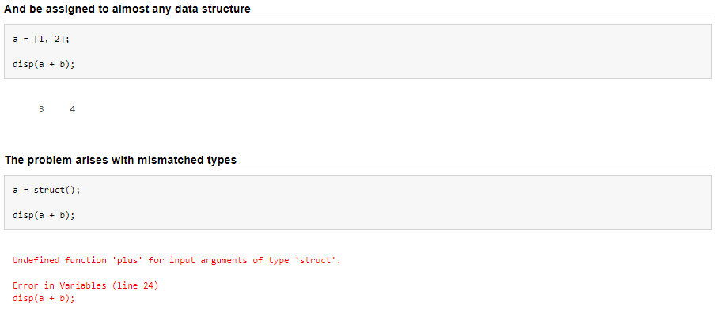
Variables
Variables are containers for a data type, so that they can be referenced throughout a program

Slide 6
Variables
For the most part, variables are passed by copy, not by reference:
By copy
By reference
x = 2;
y = x;
y = y * 2
disp(y)
>> 4
disp(x)
>> 2
x = 2;
y = x;
y = y * 2
disp(y)
>> 4
disp(x)
>> 4

Slide 7
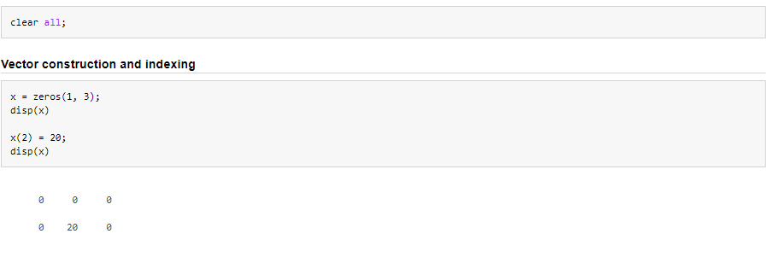
Vectors, matrices and indexing

Slide 8
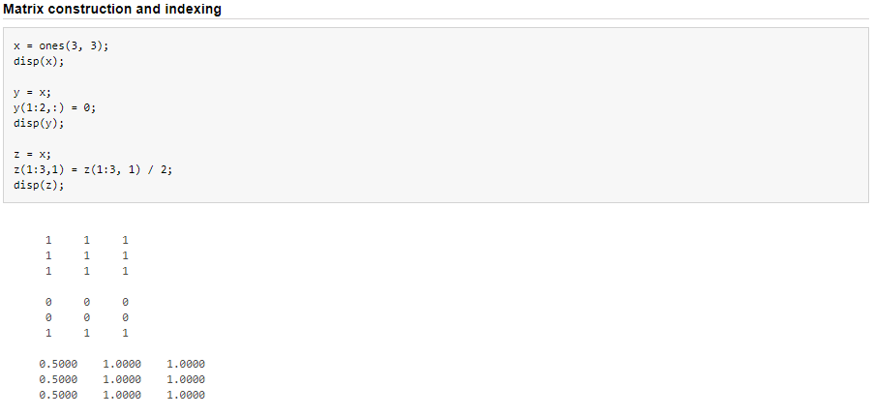
Vectors, matrices and indexing

Slide 9
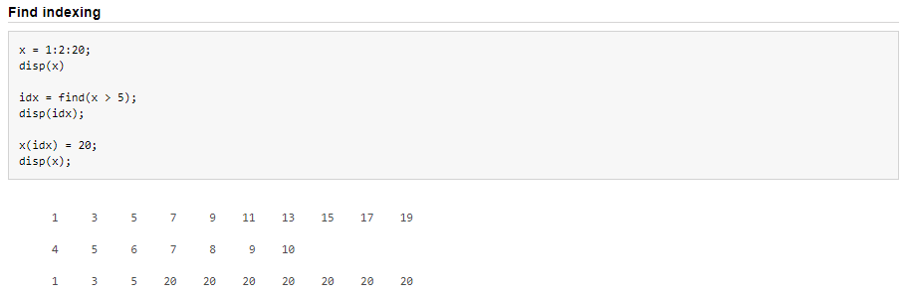
Vectors, matrices and indexing

Slide 10
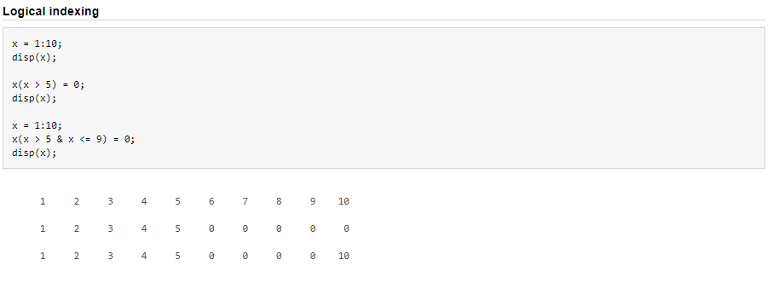
Vectors, matrices and indexing

Slide 11
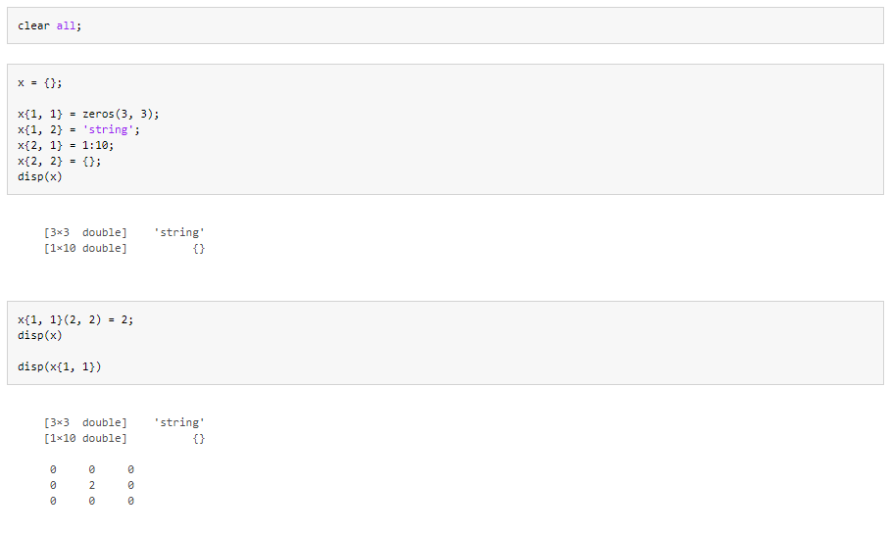
Cells and cell indexing

Slide 12
Functions
addFunc()
x
result
y
result = x + y

Slide 13
Functions
addFunc()
var1
x
result
var3
y
var2
result = x + y

Slide 14
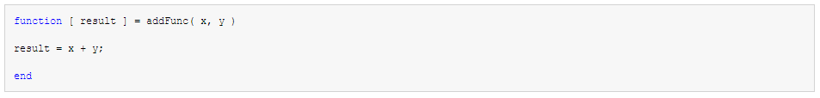
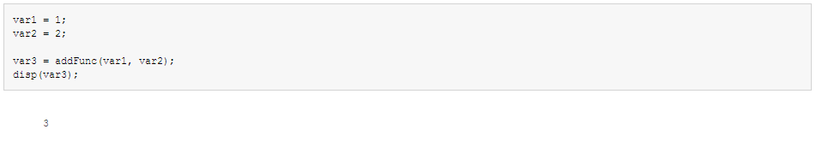
Functions

Slide 15
Control flow – if
if some-condition
do something
elseif different-condition
do something different
elseif yet-another-different-condition
do something else different
else
none of the conditions are true, do something else
end

Slide 16
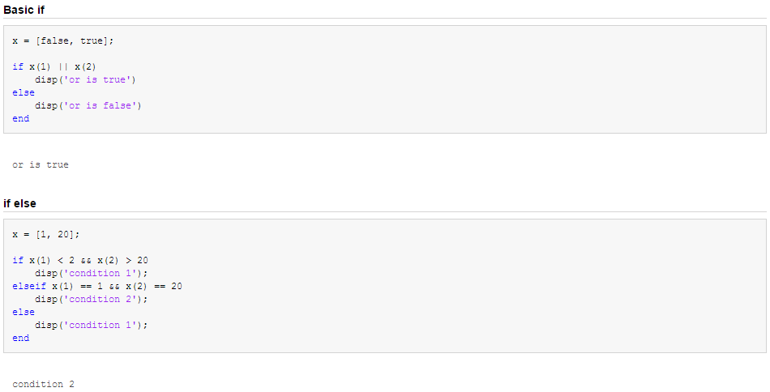
Control flow – if

Slide 17
Control flow – for
for var = some-set-of-values
do something
end

Slide 18
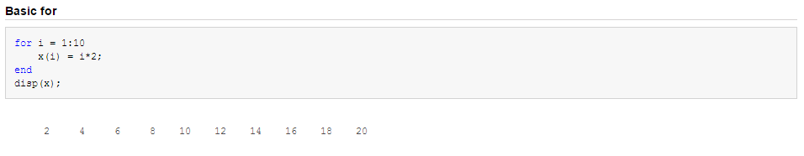
Control flow – for

Slide 19
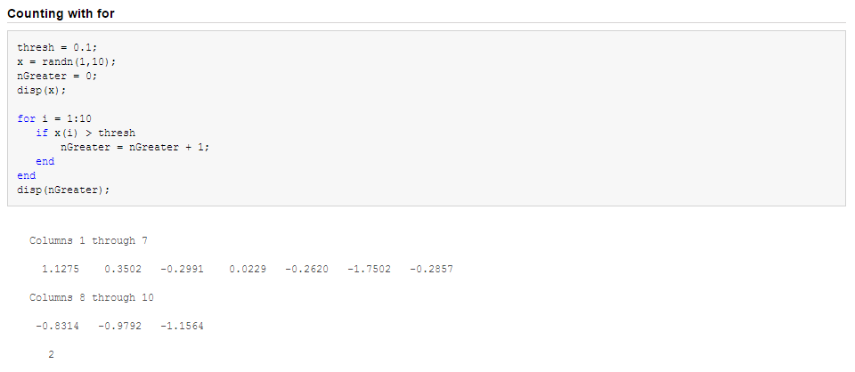
Control flow – for

Slide 20
Control flow – while
while some-condition
do something
end

Slide 21
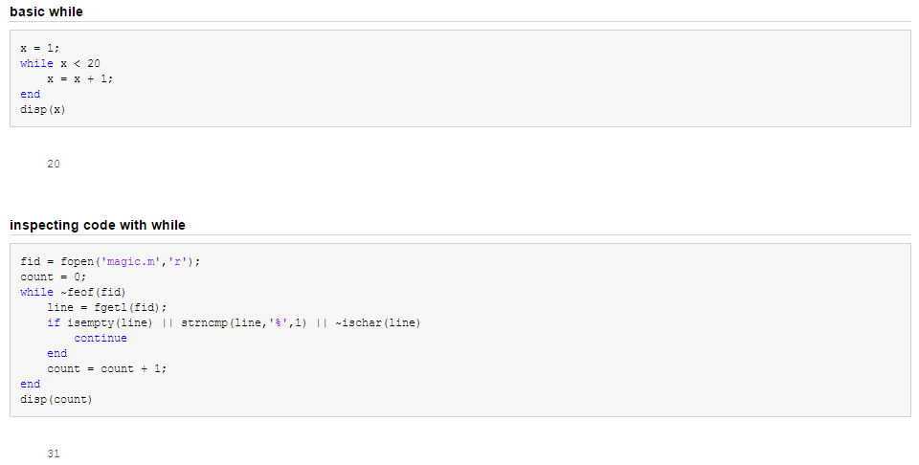
Control flow – while

Slide 22
Control flow – try, catch
try
do something
catch
if it fails, do something else
end

Slide 23
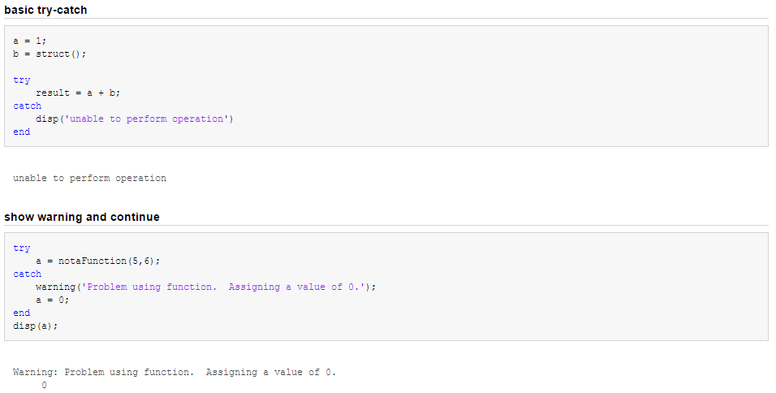
Control flow – try, catch

Slide 24
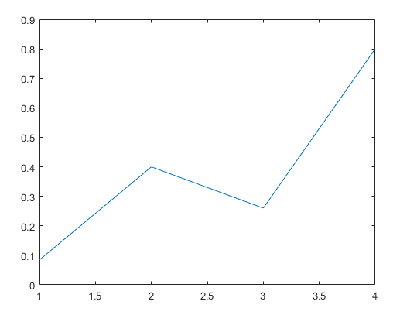
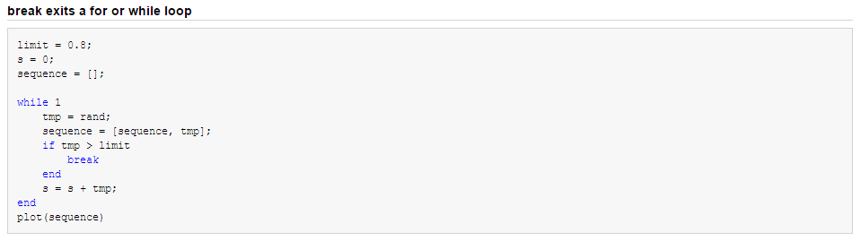
Control flow – break

Slide 25
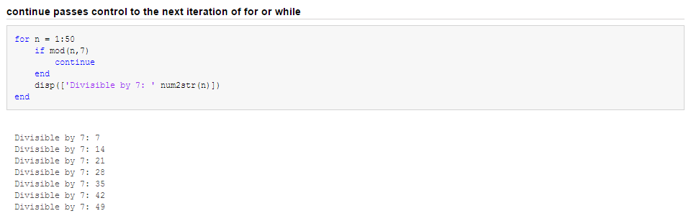
Control flow – continue

Slide 26
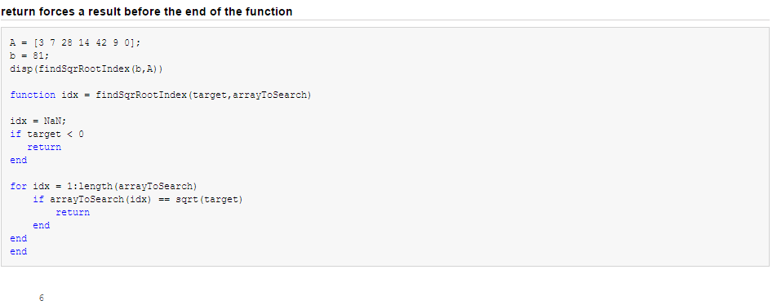
Control flow – return

Slide 27
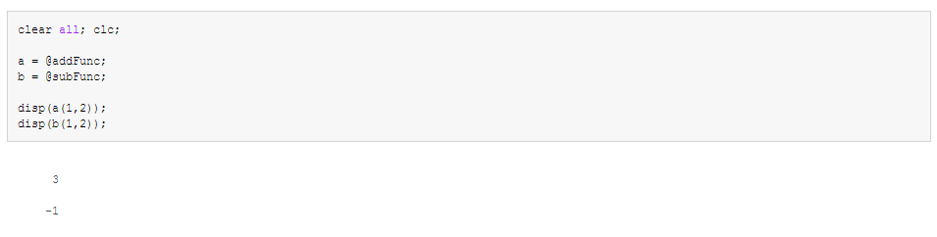
Function handles
Functions can be stored in variables, like data types

Slide 28
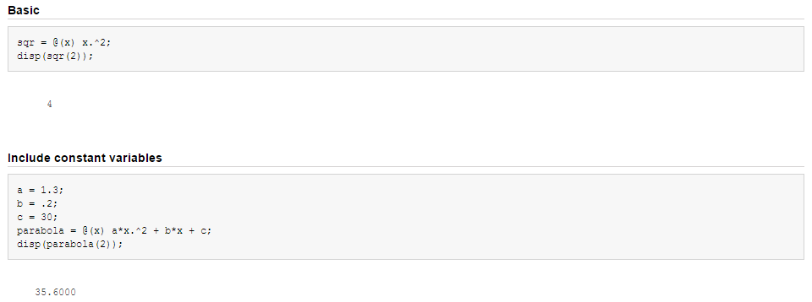
Anonymous functions
Functions can be defined like a variable, instead of writing them to a file

Slide 29
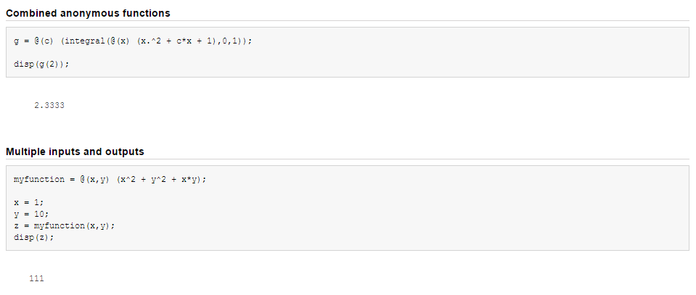
Anonymous functions
Functions can be defined like a variable, instead of writing them to a file

Slide 30
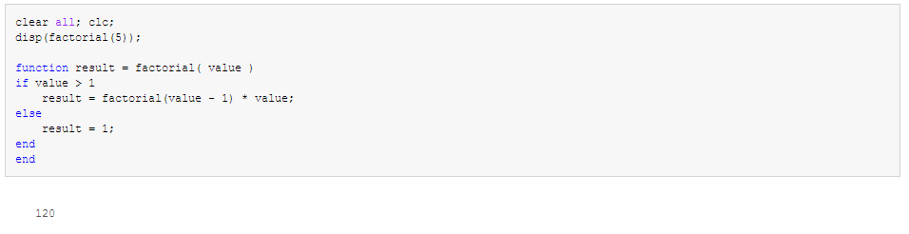
Recursion
“To understand recursion you must first understand recursion”
A recursive function in one that references itself in its own definition

Slide 31
OOP in MATLAB
Object oriented programming
Promotes reusability and maintainability of source code, great for large and/or collaborative projects
“Responsibility driven design” – objects share a ‘contract’ with each other
A very simplified view:
- Longer to prototype, but more robust overall

Slide 32
OOP in MATLAB
Centred around classes. A class is a definition of an object type.
There can be many instances of a class → objects
A class has at its most basic:
  Properties (variables)
  Methods (functions)
And can have many more useful features:
  Constructors – how will this object be initialised?
  Getters and setters – if I want to get or change data in an object, do I want to check or manipulate anything first?
  Access settings – do I want other classes to be able to change features of my object or not?
  Events – do I want anything to be triggered when something happens in my class?
  Static properties and methods – do I want anything to be shared across all instances of a class?
  Inheritance and subclassing – in some cases my classes may share properties with a parent class, but with some specific differences
  Abstraction – I know a particular template for my classes, but each class type will have its own specific implementation

Slide 33
OOP in MATLAB
Animal
Dog :: Animal
Pug :: Dog
properties:
dob:
properties:
(dob:)
coat colour:
properties:
(dob:)
(coat colour:)
methods:
methods:
bork():
playNoise(‘bork.wav’)
methods:
bork():
playNoise(‘brork.wav’)

Slide 34
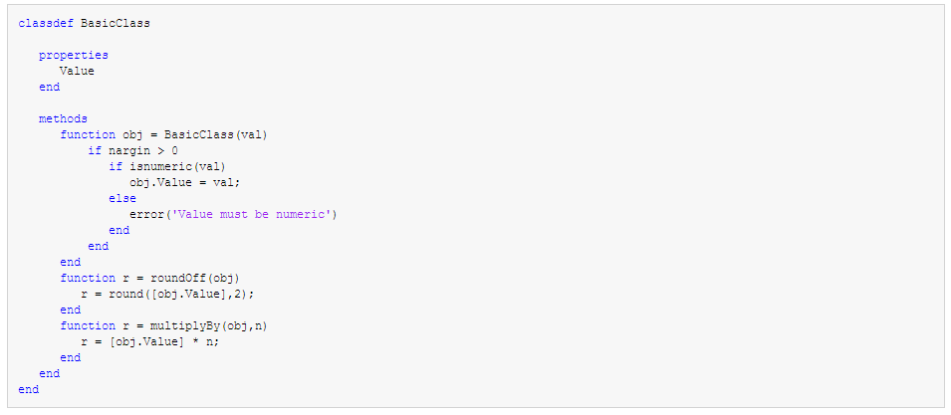
OOP in MATLAB – basic definition

Slide 35
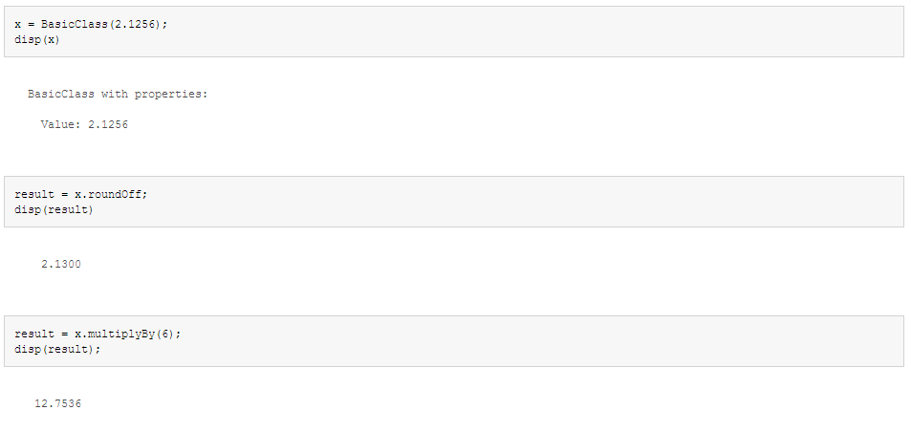
OOP in MATLAB – basic definition

Slide 36
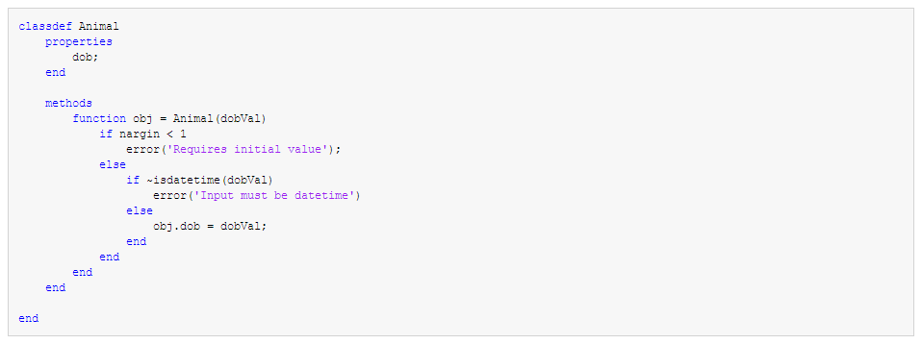
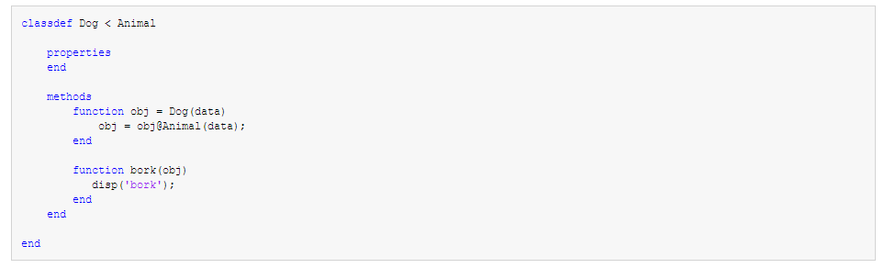
OOP in MATLAB – inheritance

Slide 37
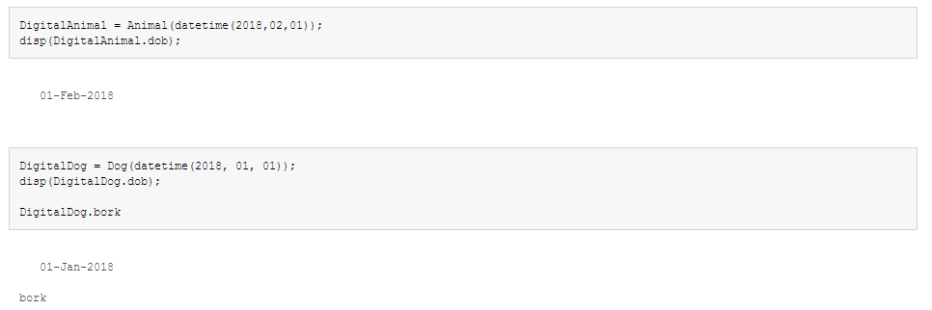
OOP in MATLAB – inheritance

Slide 38
OOP in MATLAB
Fully featured example:
https://uk.mathworks.com/help/matlab/matlab_oop/developing-classes-typical-workflow.html

Slide 39

MATLAB Challenge
https://www.mathworks.com/matlabcentral/cody/

Slide 40
MATLAB Challenge Extra – Ninja Solutions
Try the first challenge in ‘Cody Challenge’
Look at the score of the top solution
…
what
no
how
repeat

